Slide 1
PBL Case 1308
Congenital Heart Disease
William R. Davidson, Jr., M.D.
Images courtesy of Dr. Elizabeth Adams, pediatric cardiology and adult congenital heart disease, Penn State HMC.

Slide 2
Echo is the primary tool for the diagnosis and quantification of congenital heart disease today. These images represent some diagnostic images from cases similar to the mini-cases of case 317. Unlike catheterization, each lesion requires different views to make the diagnosis. That’s why you are learning the concepts of obstruction and shunt from cath data, it’s always the same layout. These images are illustrative and enriching, typical of current cardiology practice and will NOT be on the exam. The lesions and concepts of CHD from lecture and mini-cases will be on the exam. Similar images will be seen in the class lectures on embryology and congenital heart disease

Slide 3
Guide to slides
Number of slides/case:
1 VSD
3 secundum ASD
2 PDA
3 TOF
2 AV septal defect
Abbreviations:
LV, RV – ventricles
LA, RA – atria
Ao – aorta
AV – aortic valve
PA pulmonary artery
LPA, RPA – main left and right PAs
For freeze frames, go into Normal mode and click and drag the play bar.
Explanatory text can also be viewed in the Normal mode.

Slide 4
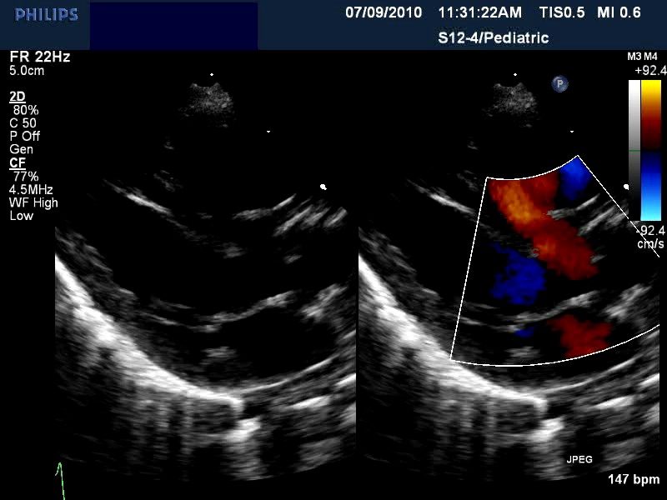
Large perimembranous VSD
RV
Ao
LV
LA
Notes:
A wide red jet courses from LV to RV in systole. A unrestricted (large) VSD in a young child. Defect is denoted by the yellow arrow.

Slide 5
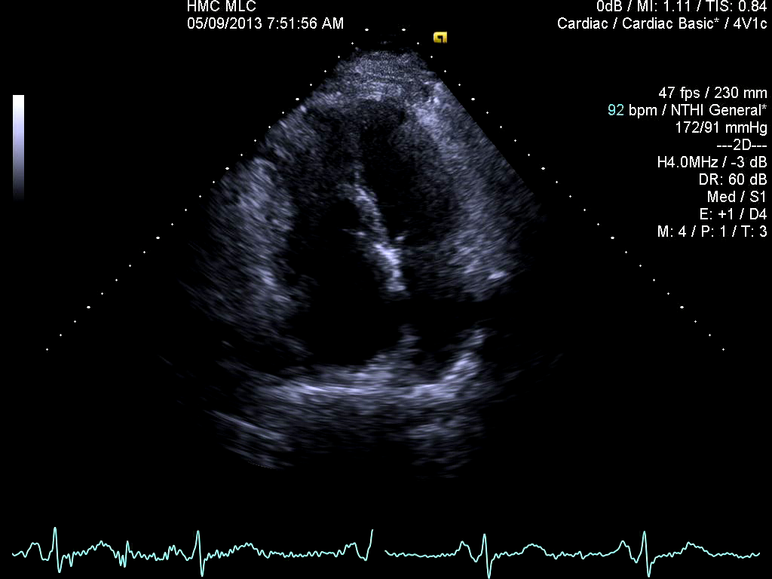
Secundum ASD in 67 year old woman
LV
RV
LA
RA
*
Notes:
Apical four chamber view of an ostium secundum ASD in a 67 year old woman. RV is much greater in area in this view than the LV indicating RV volume overload consistent with a significant ASD. The ASD itself is indicated by the yellow asterisk and is 2-3 cm in diameter in this imaging plan (BIG). Defect was first found in mid 2013 and was complicated by severe tricuspid regurgitation and atrial fibrillation and was closed in January, 2014 with tricuspid valve repair.

Slide 6
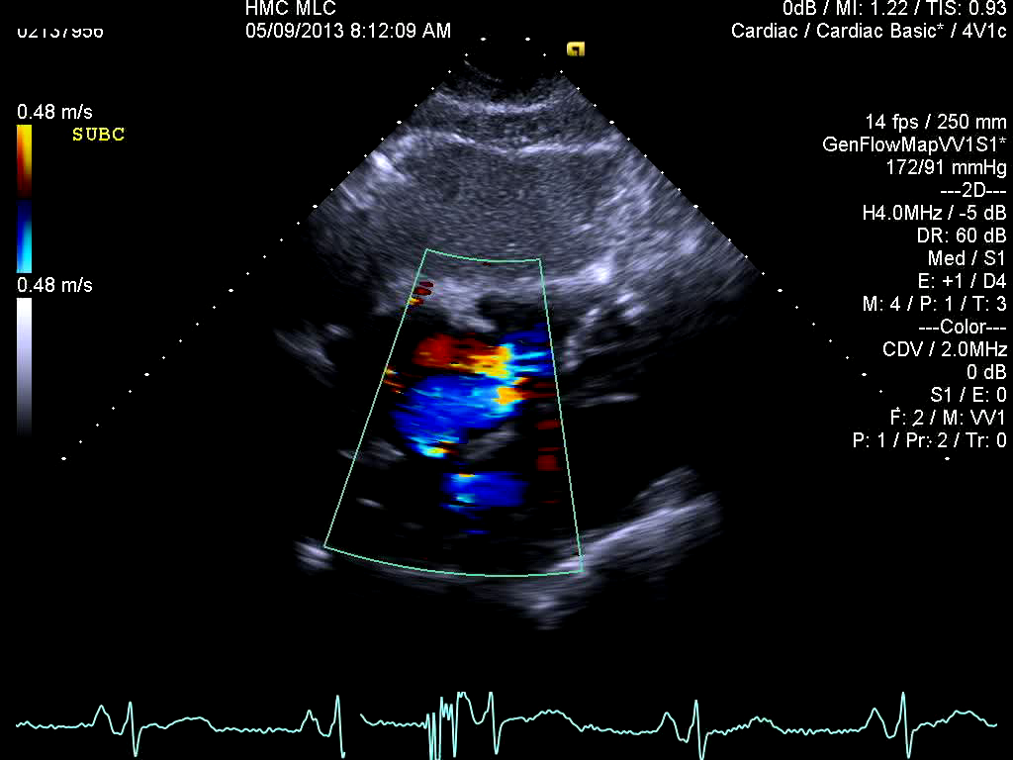
Secundum ASD in 67 year old woman
RV
RA
LV
LA
Notes:
Subcostal 4 chamber view emphasizing the atrial septum and the shunt (denoted by yellow arrow) across it (red flow signal starting at level of septum and entering RA primarily in diastole, blue, disturbed signal of severe tricuspid insufficiency fills the RA in systole. (2 explanatory stills on next slide)

Slide 7
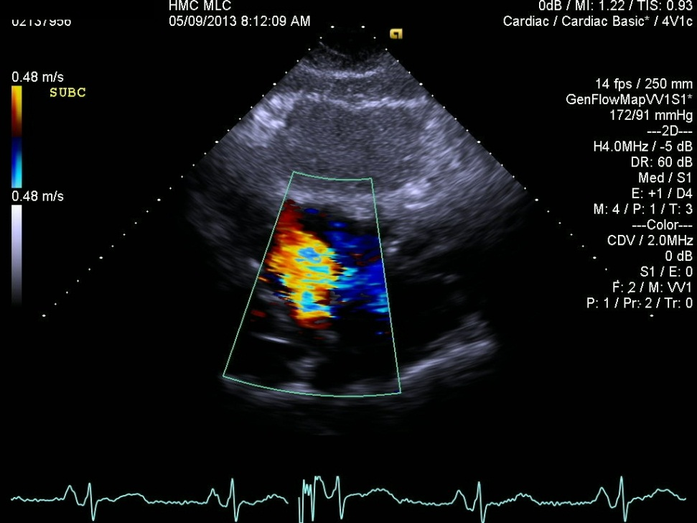
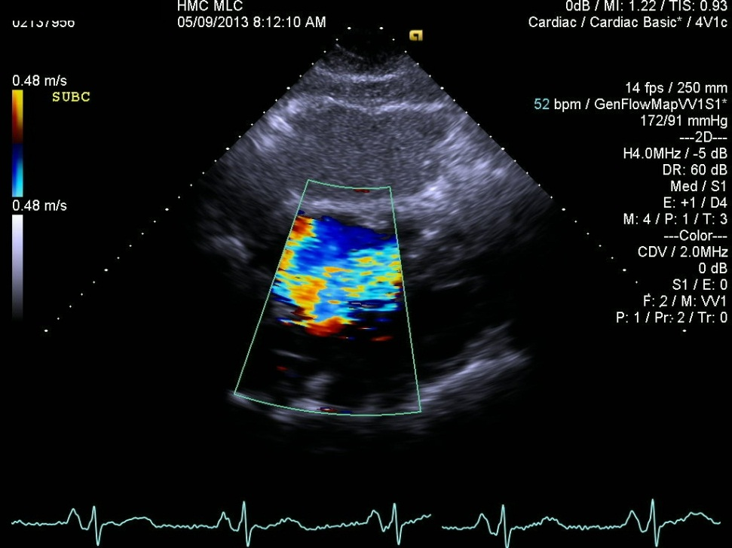
Secundum ASD in 67 year old woman
Red signal of shunt crosses atrial septum in diastole (white arrow).
Disturbed blue/multicolored jet of tricuspid insufficiency in systole (yellow arrow).

Slide 8
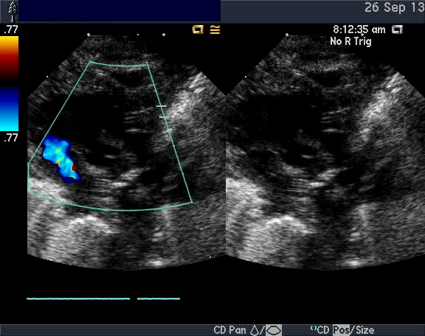
Patent Ductus Arteriosus
RV
PA
RA
Notes:
A small red jet of a PDA enters the pulmonary artery (PA), headed toward the pulmonic valve (yellow arrow) . This is a parasternal short axis view. The aortic valve is seen in cross-section in the center of the image. The right heart appears ‘draped’ over it’ from RA to RV to PA. Normally the great vessels (Ao and PA) cross at almost right angles. The aorta is directed towards the head, the PA is directed posteriorly towards the back.

Slide 9
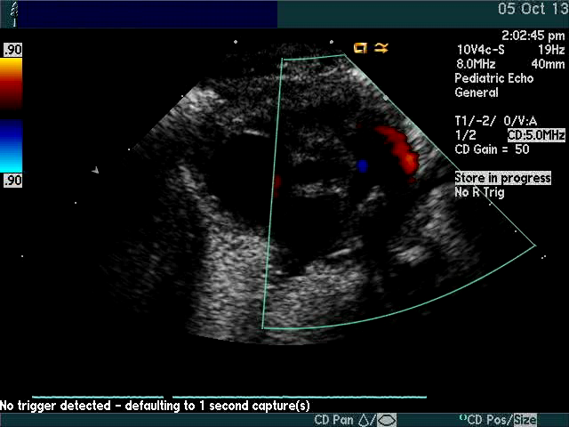
Patent Ductus Arteriosus
RV
PA
RA
Notes:
Another very small (narrow) PDA in red, entered the left PA, directed towards the pulmonic valve. Same orientation of image as in the prior study. Antegrade flow is seen as a broad blue jet from the RV toward the PAs.

Slide 10
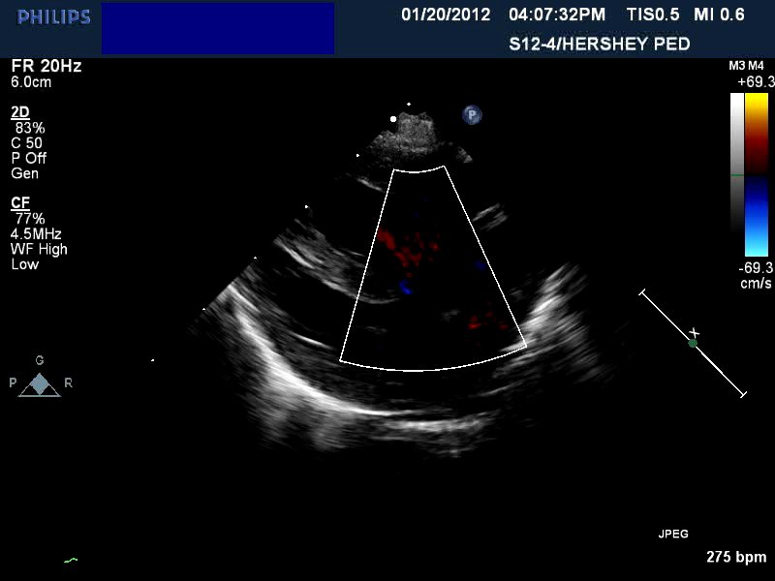
Tetralogy of Fallot
RV
LV
Notes:
A large VSD, similar in location to the VSD in mini-case 317-1. More difficult to appreciate is that the aorta overrides (straddles) the ventricular septum. Also, a blue flow signal through the VSD and into the LV indicates a right-to-left shunt.

Slide 11
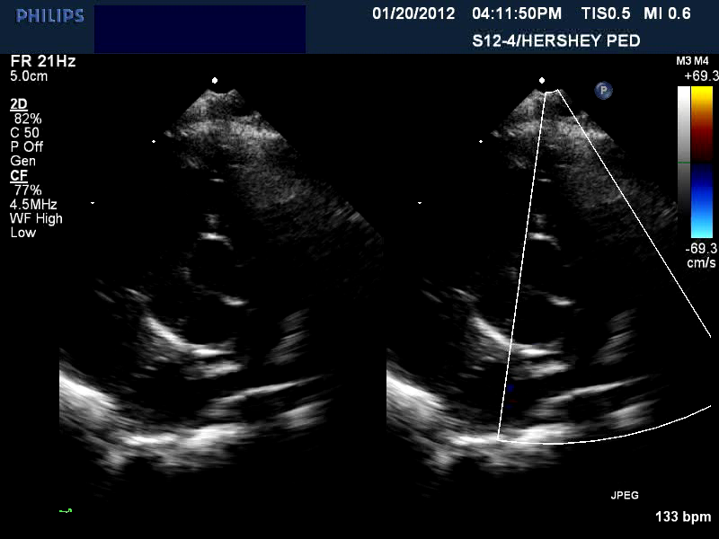
Tetralogy of Fallot
RV
PA
AV
RA
LA
Notes:
Obstruction in the RV outflow tract and at the pulmonic valve is seen. The disturbed, multi-color systolic jet in the PA (yellow arrow) indicates obstruction which can be quantified by continuous wave Doppler.

Slide 12
Tetralogy of Fallot
VSD
RV
VSD
PA
PAs
Notes:
A freeze-frame apical image showing multi-color disturbed flow in PAs and RV outflow tract. LPA and RPA are hypoplastic (smaller than normal), indicated by pair of images at bottom of image. The large VSD with right-to-left shunt from RV to LV which causes cyanosis is indicated by the red arrow. Obstructing muscle bands seem to divide the RV from the PA.

Slide 13
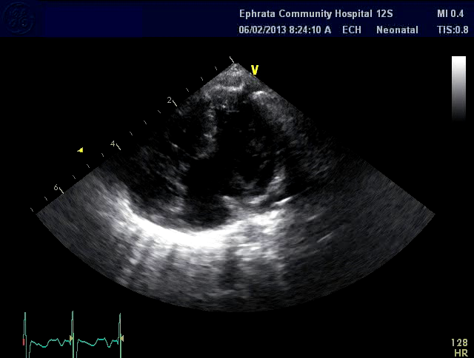
Atrioventricular Septal Defect
RV
LV
*
**
LA
RA
LA
Notes:
Also known as an AV canal defect or an endocardial cushion defect, this from an infant. An apical 4 chamber view showing a large VSD, an ostium primum atrial septum just above the AV valve (double asterisk) and a common AV valve (a single AV valve covering both the right and left AV junctions). Try sliding the play bar back and forth while paused.

Slide 14
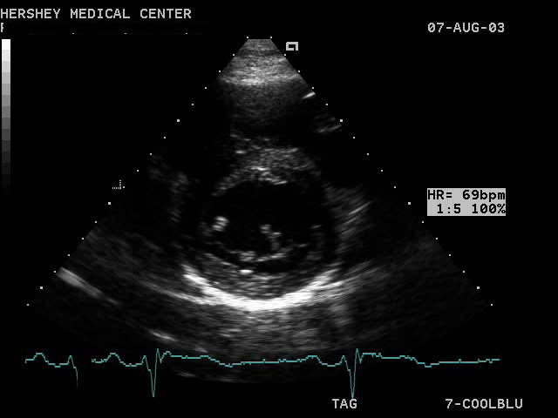
Cleft Mitral Valve
RV
LV
*
Notes:
Virtually all AV septal defects have either a common AV valve or two AV valves with a cleft in the left AV valve and sometimes the right as well. Here in a short-axis cross-section through the ventricles and the left AV valve (not a true mitral valve) the anterior leaflet can be seen to be made up of two leaflets instead of one with a cleft (asterisk) between them. The cleft can be the cause of significant left AV valve regurgitation.

